Slide 1
Backend - WebServers
Pravin Y Pawar

Slide 2
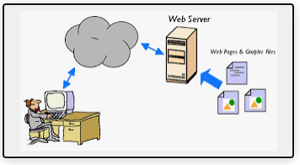
Web Server
Defined
All computers that host websites must have web server software
Software and hardware that uses HTTP (Hypertext Transfer Protocol)to respond to client requests made over the World Wide Web
Main job of a web server is to display website content through storing, processing and delivering webpages to users
Also support SMTP (Simple Mail Transfer Protocol) and FTP (File Transfer Protocol), used for email, file transfer and storage
Web server hardware is connected to the internet and allows data to be exchanged with other connected devices
software controls how a user accesses hosted files
Used for
web hosting
hosting of data for websites
web applications

Slide 3
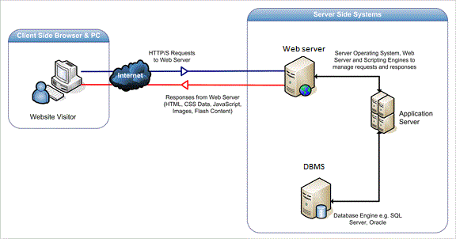
Web Server
Working
Accessed through the domain names of websites and ensures the delivery of the site's content to the requesting user
The software side at least an HTTP server - understand HTTP and URLs
The hardware side, a computer that stores web server software and other files related to a website, such as HTML documents, images and JavaScript files
A user needs a file hosted on web server
A person will specify a URL in a web browser's address bar
The web browser will then obtain the IP address of the domain name -- translating the URL through DNS (Domain Name System)
The browser will then request the specific file from the web server by an HTTP request
When the request is received by the web server,
the HTTP server will accept the request
find the content
send it back to the browser through HTTP
If the requested page does not exist or if something goes wrong, the web server will respond with an error message. The browser will then be able to display the webpage.
Image source : stackoverflow

Slide 4
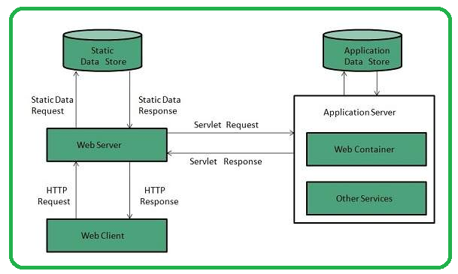
Web Server - Types
Dynamic vs. static web servers
A web server can be used to serve either static or dynamic content
Static refers to the content being shown as is
Dynamic content can be updated and changed
A static web server
Consist of a computer and HTTP software
Considered static because the sever will send hosted files as is to a browser
Dynamic web server
Consist of a web server and other software such as an application server and database
Considered dynamic because the application server can be used to update any hosted files before they are sent to a browser
Can generate content when it is requested from the database
Process is more flexible, it is also more complicated
Image Source : TutorialsPoint

Slide 5




Common Web servers
Apache HTTP Server
Developed by Apache Software Foundation
Free and open source web server
For Windows, Mac OS X, Unix, Linux, Solaris and other operating systems
Microsoft Internet Information Services (IIS)
Developed by Microsoft for Microsoft platforms
Not open sourced, but widely used
Nginx
A popular open source web server for administrators
Has very light resource utilization and scalability
Can handle many concurrent sessions due to its event-driven architecture
Can be used as a proxy server and load balancer
Sun Java System Web Server
A free web server from Sun Microsystems that can run on Windows, Linux and Unix
Well-equipped to handle medium to large websites

Slide 6
Thank You!
In our next session:

